Slide 1
Modelling Producer-Consumer Problem
CHUA KWAN LIANG CB11035
ELVIRA ARIAPUTRA CB13125
WONG LIANG JI CB13016
LIM SENG KEE CB11049
CHEAH JIT CHOON CB11091

Slide 2
Introduction
TLA is a specification language combination of temporal logic with actions logic that is used to express behaviors of concurrent systems.

Slide 3
MCP Problem
Modelling producer-consumer problem which is also known as the bounded-buffer problem
multi-purpose synchronization problem
Two process: Producer, Consumer

Slide 4
Objective
having a better understanding on TLA specification
Solving the deadlock problem for Modeling Producer-Consumer
understand the usefulness of formal method in computer programs in our daily life

Slide 5
enhance the relationship among the group members
solve the task of Modelling Producer-Consumer problem with a solution in TLA format

Slide 6
PROJECT DESCRIPTION
The main goal is to make sure that the buffer state is fully occupy by data and will not empty.
Buffer is fully loaded, producer will stop sending.
Buffer is nearly empty then the producer will start to send.

Slide 7
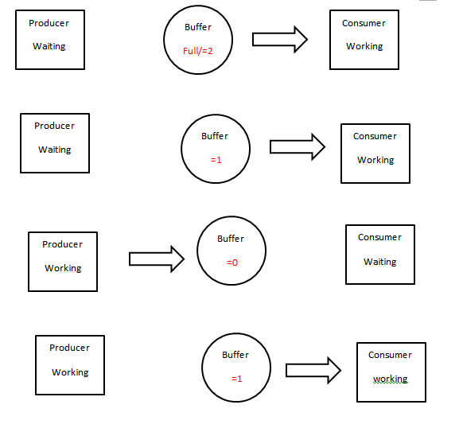

Slide 8
Conclusion
TLA specification for producer-consumer problem.
Variables interacts with each other and an error that hidden in a line of specification will render the entire specification not executable.
Model checking tools that is a sub module of the TLA toolbox which we can feed the constant with not only an ordinary assignment but also model value.
Formal method can help the development of the system and reduce the hidden bug.

